Slide 1

Intro

Slide 2
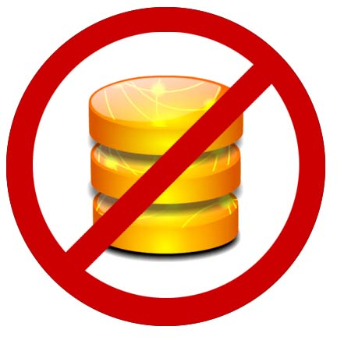
What Will NOT be Covered
DB Stuff -> Serializing your model into the document
DB Stuff->Upserting changes to restful endpoints
Unit Testing your Models
Backbone Routers, History

Slide 3
What WILL be Covered: the basics of client-side MV* frameworks
Models
Views
How to connect them to make your app work good.

Slide 4
Spa-Query
Spaghetti-jquery
$(document).ready(function() {
$(‘#foo’).click(function() {
$.ajax(‘/url’,a, function(er) {
});
}):
});
function a() {
}

Slide 5
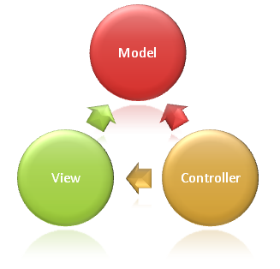
Server Side MVC Frameworks connect models and views with HTTP verbs: GET, POST, etc. over the Request/Response Cycle

Slide 6
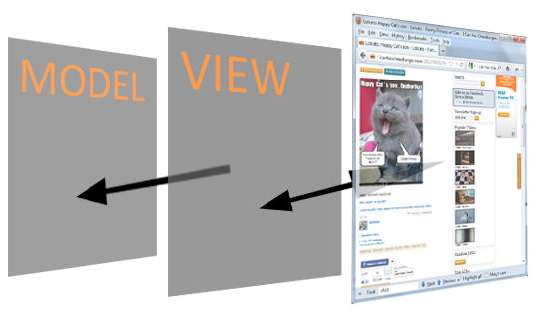
Client Frameworks connect models and views and respond to DOM events onclick, etc. in the window.
No longer simulating a stateful a process

Slide 7
Some of the Players
Backbone.js
Knockout.js
Ember.js
Spine.js
Jquery UI widgets (not flexible enough)
A whole slew of others, but it is the first two that have the most momentum right now

Slide 8
What is Backbone?
-base classes
-system of conventions

Slide 9
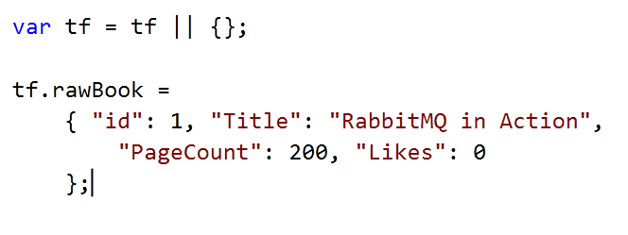
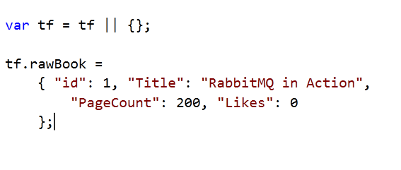
Consider this Book Data Model

Slide 10
Pretty Simple:
Extend Backbone.Model and create instance
Extend Backbone.View and create instance that references the model
Call viewinstance.render() and append el property to DOM

Slide 11
BackBone.Model
Prototype for your JSON data object that adds:
Attributes dictionary - Getter/Setter
Event subscription
Built-in plumbing for saving back to server (not covered)
Custom methods

Slide 12
Views are used to generate a DOM node with HTML content and events that references an underlying MODEL instance
Reference a model
Override render()
Configure event delegates

Slide 13

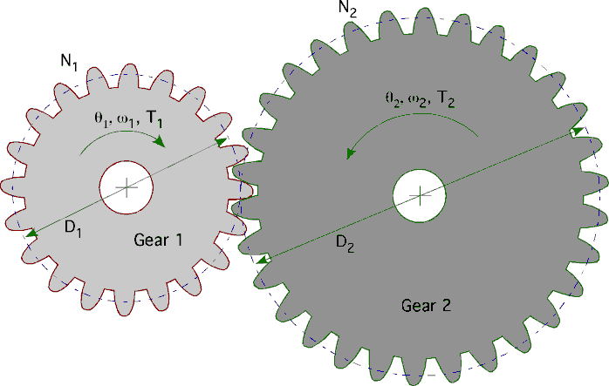
So what?? BFD, this looks like a LOT of code and all it does it increment likes.
Maintainable
Maintainable
Maintainable

Slide 14
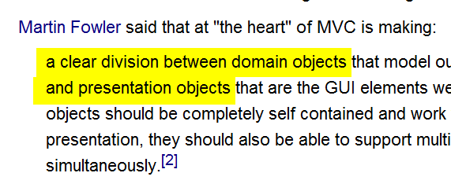

A Guru Speaks
Source: Wikipedia article on MVC

Slide 15
BackBone.Collection & More
Model Reuse
Array of Model with add/remove callbacks, array extensions

Slide 16
What Else?
Persistence -> Backbone.sync Build RESTful API's with ASP.NET Web API John V. Petersen at 1:45pm
Underscore.js
Validation is built in, but best for mobile/quick hits
TDD -> JavaScript Testing John V. Petersen at 3:15pm today

Slide 17
Final Observations
There is a landscape of MV* frameworks
Backbone is deep/flexible and unveils itself at your pace
Little code, more convention
The awesome documentation

Slide 18

Client Side Technology is already pretty mature – right now
The apps you know and love are using it
Viva the client-side utopia!

